Slide 1
Lean Management- Meaning
It is A customer focused waste elimination method that makes the process and there by organization lean (eliminating fat)
In A lean company, employees always look to improve their skills and improve the processes. Products and services are driven in right amounts, to right location, at the right time and in the right condition.
It is long term approach to work that systematically seeks to achieve small , incremental changes in processes in order to improve efficiency and quality
Lean management seeks to eliminate any waste of time , effort or money by identifying each step of business process and then revising or cutting out steps that do not create value
The goal of lean thinking is the creation of A continuous stream which delivers customer value with the least waste of resources within the shortest possible time.

Slide 2
Lean Philosophy
Lean is a culture of continuous improvement practiced at every level of organization and by every team.
Lean is application of scientific method and study of work processes to find improvements
Lean is respect for people. It is respect for the voice of customer and it is respect for those who do the work.
Lean is elimination of waste in all its forms. lean is the ability to distinguish between work that actually add the value to the customers and work that does not. Waste elimination helps to free resources that can be used in value adding activities.
Lean is a work environment that assures quality and safety of all work for customer and staff.
Lean is a focus on improving the work process and not on blaming peoples

Slide 3
Lean is culture of teamwork, shared responsibility and ownership that cuts through organization walls.
Lean is culture that returns the joy to work. Honda speaks three joys of buying, selling and making the product. We do our best work when we have joy in our work.
Lean is flow. Lean is an interruption free process that flows from beginning to end without interruption.

Slide 4
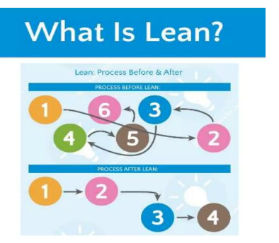

Slide 5
Guiding Principles of Lean Management
Defining value from the standpoint of the end customer
Identify each step in business process and eliminating those steps that do not create value.
Making value- creating steps occur in tight sequence.
Repeating the first three steps on a continuous basis until all waste has been eliminated.

Slide 6
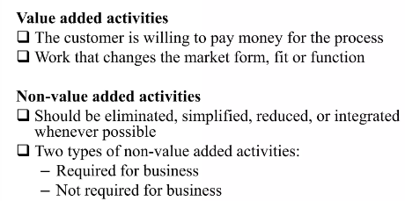

Slide 7
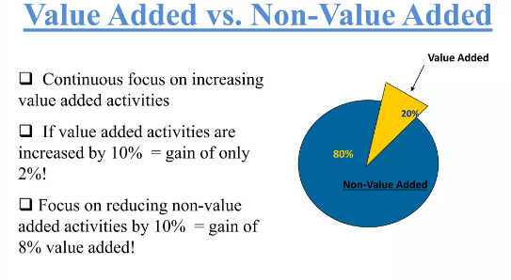

Slide 8
The 3 M’s of Lean
Lean manufacturing is a Japanese method focused on 3M’s. These Ms are: muda, the Japanese word for waste, mura, the Japanese word for inconsistency, and muri, the Japanese word for unreasonableness.
Muda specifically focuses on activities to be eliminated. Within manufacturing, there are categories of waste. Waste is broadly defined as anything that adds cost to the product without adding value to it. Generally, muda (or waste) can be grouped into the following categories: 1.Excess production and early production
2.Delays
3.Movement and transport
4.Poor process design
5.Inventory
6.Inefficient performance of a process
7.Making defective items

Slide 9
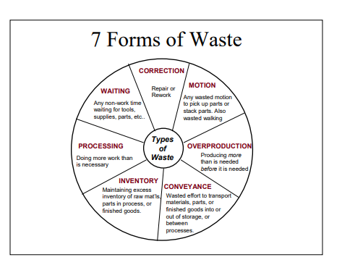

Slide 10
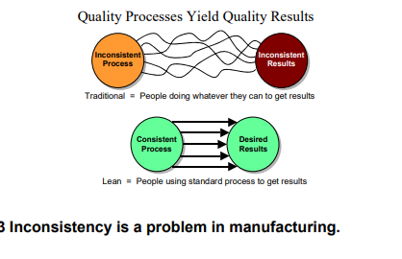
The second “M” is for mura, or inconsistency. Inconsistency is a problem that increases the variability of manufacturing. Mura is evidenced in all manufacturing activities ranging from processing to material handling to engineering to management.

Slide 11
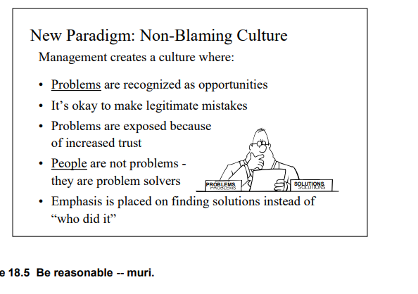
The final “M” is for muri or unreasonableness. Muri applies to a variety of manufacturing and management activities. For instance, Figure shows an example of being unreasonable by blaming someone for problems rather than looking at resolution of problems. It is unreasonable to blame rather than mitigate issues. This is true for all manufacturing activities -- do what is reasonable. Don’t be emotional!

Slide 12
The 5 S’s of Lean
Much of Lean manufacturing is applying “common sense” to manufacturing environments. In implementing Lean, 5 S’s are frequently used to assist in the organization of manufacturing. The 5 S’s are from Japanese and are:
•Seiri (sort, necessary items)
•Seiton (set-in-order, efficient placement)
•Seison (sweep, cleanliness)
•Seiketsu (standardize, cont. improvement)
•Shitsuke (sustain, discipline)

Slide 13
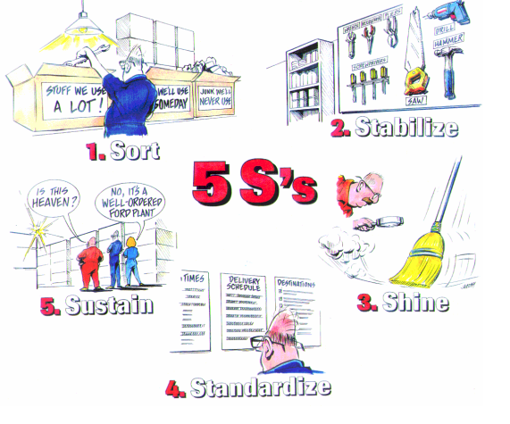

Slide 14
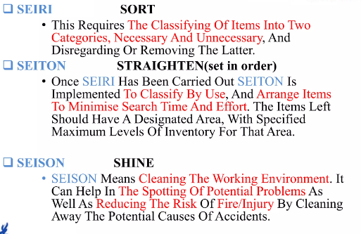

Slide 15
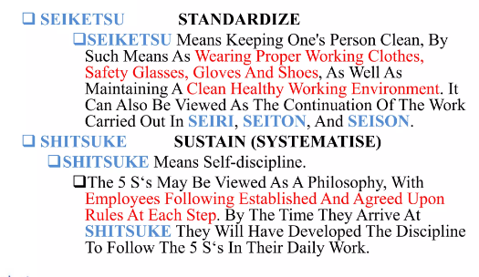

Slide 16
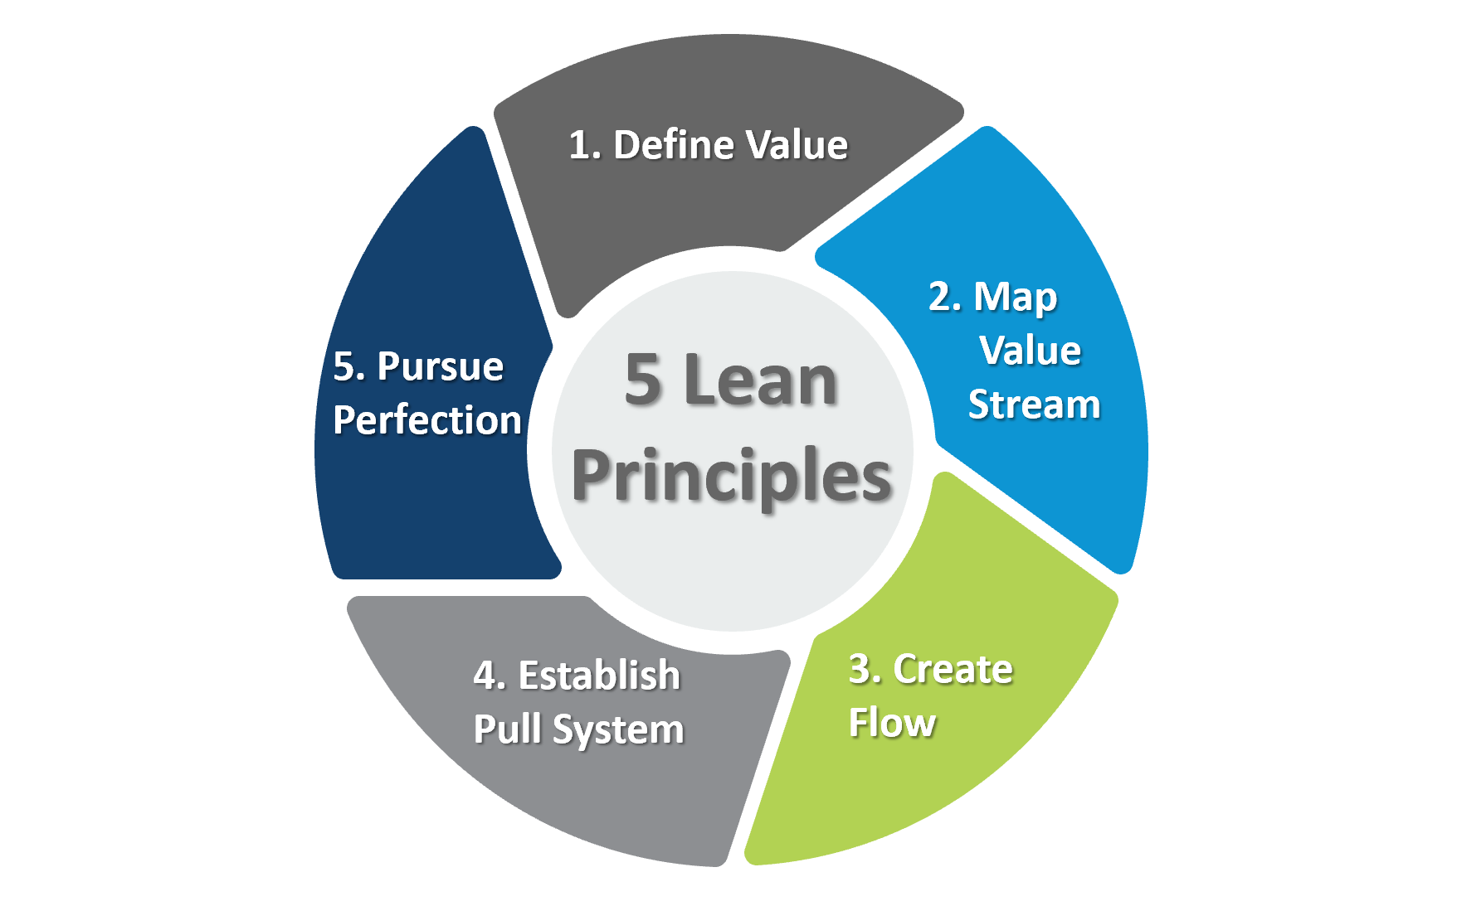
The Five Steps of Lean Implementation

Slide 17
The Five Steps of Lean Implementation
Step 1: Specify Value - Define value from the perspective of the final customer. Express value in terms of a specific product, which meets the customer's needs at a specific price and at a specific time.
Step 2: Map- Identify the value stream, the set of all specific actions required to bring a specific product through the three critical management tasks of any business: the problem-solving task, the information management task, and the physical transformation task. Create a map of the Current State and the Future State of the value stream. Identify and categorize waste in the Current State, and eliminate it!
Step 3: Flow- Make the remaining steps in the value stream flow. Eliminate functional barriers and develop a product-focused organization that dramatically improves lead-time.
Step 4: Pull- Let the customer pull products as needed, eliminating the need for a sales forecast.
Step 5: Perfection- There is no end to the process of reducing effort, time, space, cost, and mistakes. Return to the first step and begin the next lean transformation, offering a product that is ever more nearly what the customer wants.

Slide 18
6 Benefits of Lean Management
A Decrease in Cost
— Lean management is all about maximizing profits. While the selling price is impacted by various factors that could depend on product qualities or markets, usually companies can do more to control their costs, and lean practices help to decrease costs so that all savings can be added to profit.
Improved Customer Interactions
— Lean management began with the customer’s viewpoint in mind. The way they communicate with staff, responsiveness to their concerns, and their experience with the product are some of the leading drivers of cutting wasteful practices. — If customer surveys are skewing a certain way, then leaders should pay attention to what the company can stand to lose. — As a result, customer interactions and overall service should improve.

Slide 19
Increased Quality
— Lean management is also about a great deal of attention being paid to details. — The goal is to decrease the number of defects and reworks in products. — This action means that processes will be optimized to avoid mistakes which saves time that workers will have to take to remake products, and the money needed to pay them for the labor.
An Improvement Culture
— When a company understands the importance of lean management and begins to implement the strategies, then a new way of thought begins to take over in the company. — Workers are more open to improvement and are looking for ways to consistently make the work they do even more impactful. — Introducing teams to lean management can create a culture that values daily improvement.

Slide 20
Utilization of “Push and Pull”
— Company expenses can become inflated if leaders are not paying attention to how inventory is piling up. — A strategy that can help manage this is having a “pull” over a “push” mentality. — This means that later production stages determine what is happening in earlier processes. — This can help companies prevent the problem of overproduction and paying a higher carrying cost. Companies will only order what they need.

Slide 21
Increased Employee Morale
— Since lean management favors an approach where managers are in regular communication with employees about their work and their process, employees could feel they are empowered to make better decisions. — Workers know where they stand and where they can improve to create quality work.

Slide 22
Disadvantages of Lean Management
The Problem of Inventory
— Traditionally, in lean management implementation, low amounts of stock are kept on hand to decrease carrying costs. — This causes companies to depend on suppliers and hope they are able to make the adjustment to deliver goods quickly and efficiently. — If there is any disruption of inventory processes, then it can derail the company.
Difficult to Change Over
— Employees may not always be welcoming to lean management practices. The implementation of this style will take a lot of patience and a complete overhaul to work processes. This may not be something longer-tenured workers will be comfortable with. — Therefore, leaders have to be transparent about all changes that will happen in the company. — There also has to be some time allowed for inquiries from workers who are not yet sold on the switch.

Slide 23
High Implementation Cost
— Most of the time, when lean management is implemented in a company that has never before used it, it is likely that all systems and production processes will have to end in their current state. — This event can bring high costs for companies who are not prepared for the increased expenses of bringing in new equipment and training programs.
The Temptation to Over-Structure
— Everything might not need an overhaul. The challenge for leaders is to determine what needs to be incorporated into lean management and what does not. — Leaders can push the processes beyond what they may be able to yield, so understanding the impact of incremental changes is key here.

Slide 24
Lean Management Best Practices
Have a Centralized Point-Of-Contact for Suppliers
Vendors and suppliers are going to be one of the most critical groups in the implementation of lean management. Timely communication, deliveries, and responsiveness to unforeseen issues is key to this relationship. Therefore, there should be a staff member that is dedicated to supplier management and acts as a point of contact for this group.
Apply Lean Management to Safety
Worker safety and well-being should be the primary priority for all business leaders. Lean management principles should be applied to ensuring the safety of all employees. Whether it is fixing faulty equipment or reducing work hours to ensure workers are not too exhausted it is crucial that leaders realize the importance of lean management practices with regard to safety.

Slide 25
Measure Everything
Keeping good metrics are key to knowing how much waste is being eradicated due to lean management implementation. Workers should know how well they are doing in the new system to keep morale and motivation high, while leaders should be aware if carrying costs and other expenses have decreased as a result of these new processes. As stated above, lean management can increase costs, so leaders need to know if their spending is worth it for the company.
Train Workers on Lean Management Principles
The more that workers are aware of the benefits and intricacies of lean management, the more allies leaders have in understanding the value of cutting of wasteful projects and processes. Six Sigma is a popular set of techniques and practices that address process improvements. Workers can benefit from learning these principles so they can further implement the methodology in the company. The more continuous improvement principles that employees are exposed to, the better.

Slide 26
Adopt a Change Management Approach
Leaders are going to have to become prepared for all the factors they need to take into account when preparing to change processes that adhere to continuous improvement. Leaders should develop a plan for how they are going to introduce employees to the new practices, steps to implement procedures in each department, and the future vision for the company after lean management is performed. Anything can happen, but leaders have to ensure they are planning for the actual transition.

Slide 27
Theory of Constraints (TOC)
What are Constraints?
Constraints are anything that prevents the organization from making progress towards its goal. In manufacturing processes, constraints are often referred to as bottlenecks. Interestingly, constraints can take many forms other than equipment.
Every process has a constraint (bottleneck) and focusing improvement efforts on that constraint is the fastest and most effective path to improved profitability.

Slide 28
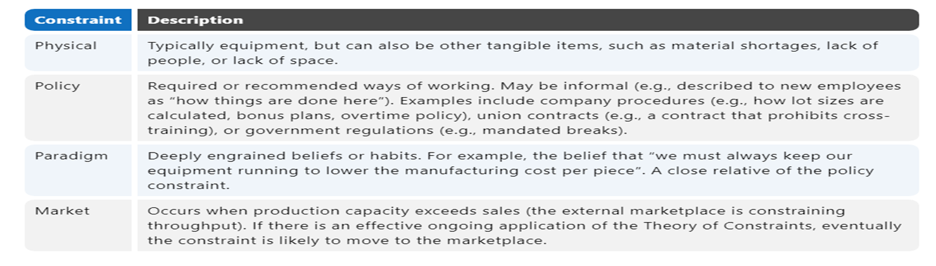

Slide 29
The Theory of Constraints is a methodology for identifying the most important limiting factor (i.e., constraint) that stands in the way of achieving a goal and then systematically improving that constraint until it is no longer the limiting factor. In manufacturing, the constraint is often referred to as a bottleneck.
The Theory of Constraints takes a scientific approach to improvement. It hypothesizes that every complex system, including manufacturing processes, consists of multiple linked activities, one of which acts as a constraint upon the entire system (i.e., the constraint activity is the “weakest link in the chain”).

Slide 30
So what is the ultimate goal of most manufacturing companies? To make a profit – both in the short term and in the long term. The Theory of Constraints provides a powerful set of tools for helping to achieve that goal, including:
The Five Focusing Steps: a methodology for identifying and eliminating constraints
The Thinking Processes: tools for analyzing and resolving problems
Throughput Accounting: a method for measuring performance and guiding management decisions
Dr. Eliyahu Goldratt conceived the Theory of Constraints (TOC), and introduced it to a wide audience through his bestselling 1984 novel, “The Goal”. Since then, TOC has continued to evolve and develop, and today it is a significant factor within the world of management best practices.

Slide 31
One of the appealing characteristics of the Theory of Constraints is that it inherently prioritizes improvement activities. The top priority is always the current constraint. In environments where there is an urgent need to improve, TOC offers a highly focused methodology for creating rapid improvement.
A successful Theory of Constraints implementation will have the following benefits:
Increased Profit: the primary goal of TOC for most companies
Fast Improvement: a result of focusing all attention on one critical area – the system constraint
Improved Capacity: optimizing the constraint enables more product to be manufactured
Reduced Lead Times: optimizing the constraint results in smoother and faster product flow
Reduced Inventory: eliminating bottlenecks means there will be less work-in-process

Slide 32
BASICS OF TOC
Core Concept
The core concept of the Theory of Constraints is that every process has a single constraint and that total process throughput can only be improved when the constraint is improved. A very important corollary to this is that spending time optimizing non-constraints will not provide significant benefits; only improvements to the constraint will further the goal (achieving more profit).
Thus, TOC seeks to provide precise and sustained focus on improving the current constraint until it no longer limits throughput, at which point the focus moves to the next constraint. The underlying power of TOC flows from its ability to generate a tremendously strong focus towards a single goal (profit) and to removing the principal impediment (the constraint) to achieving more of that goal. In fact, Goldratt considers focus to be the essence of TOC.

Slide 33
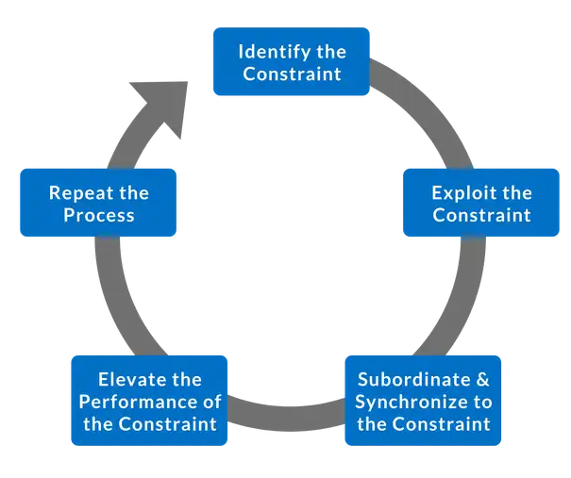
The Five Focusing Steps
The Theory of Constraints provides a specific methodology for identifying and eliminating constraints, referred to as the Five Focusing Steps.

Slide 34
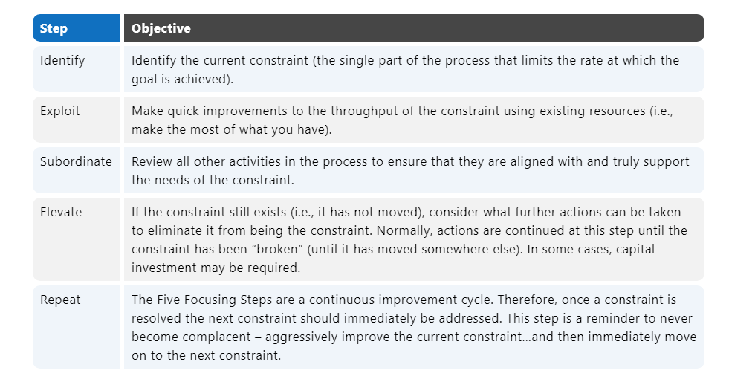

Slide 35
The Thinking Processes
The Theory of Constraints includes a sophisticated problem solving methodology called the Thinking Processes. The Thinking Processes are optimized for complex systems with many interdependencies (e.g., manufacturing lines). They are designed as scientific “cause and effect” tools, which strive to first identify the root causes of undesirable effects (referred to as UDEs), and then remove the UDEs without creating new ones.
The Thinking Processes are used to answer the following three questions, which are essential to TOC:
What needs to be changed?
What should it be changed to?
What actions will cause the change?

Slide 36
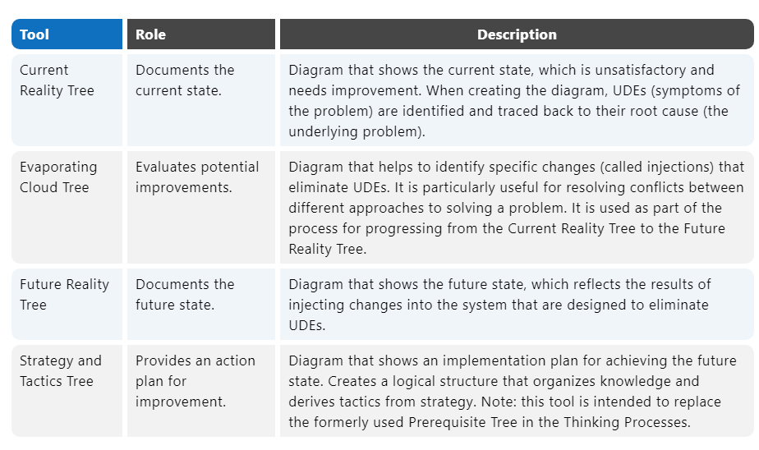
Examples of tools that have been formalized as part of the Thinking Processes include:

Slide 37
Throughput Accounting
Throughput Accounting is an alternative accounting methodology that attempts to eliminate harmful distortions introduced from traditional accounting practices – distortions that promote behaviors contrary to the goal of increasing profit in the long term.
In traditional accounting, inventory is an asset (in theory, it can be converted to cash by selling it). This often drives undesirable behavior at companies – manufacturing items that are not truly needed. Accumulating inventory inflates assets and generates a “paper profit” based on inventory that may or may not ever be sold (e.g., due to obsolescence) and that incurs cost as it sits in storage. The Theory of Constraints, on the other hand, considers inventory to be a liability – inventory ties up cash that could be used more productively elsewhere.

Slide 38
In traditional accounting, there is also a very strong emphasis on cutting expenses. The Theory of Constraints, on the other hand, considers cutting expenses to be of much less importance than increasing throughput. Cutting expenses is limited by reaching zero expenses, whereas increasing throughput has no such limitations.
These and other conflicts result in the Theory of Constraints emphasizing Throughput Accounting, which uses as its core measures: Throughput, Investment, and Operating Expense.

Slide 39
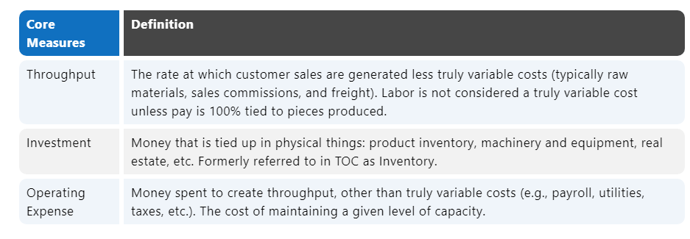

Slide 40
In addition, Throughput Accounting has four key derived measures: Net Profit, Return on Investment, Productivity, and Investment Turns.
Net Profit = Throughput − Operating Expenses
Return on Investment = Net Profit / Investment
Productivity = Throughput / Operating Expenses
Investment Turns = Throughput / Investment
In general, management decisions are guided by their effect on achieving the following improvements (in order of priority):
Will Throughput be increased?
Will Investment be reduced?
Will Operating Expenses be reduced?
The strongest emphasis (by far) is on increasing Throughput. In essence, TOC is saying to focus less on cutting expenses (Investment and Operating Expenses) and focus more on building sales (Throughput).

Slide 41
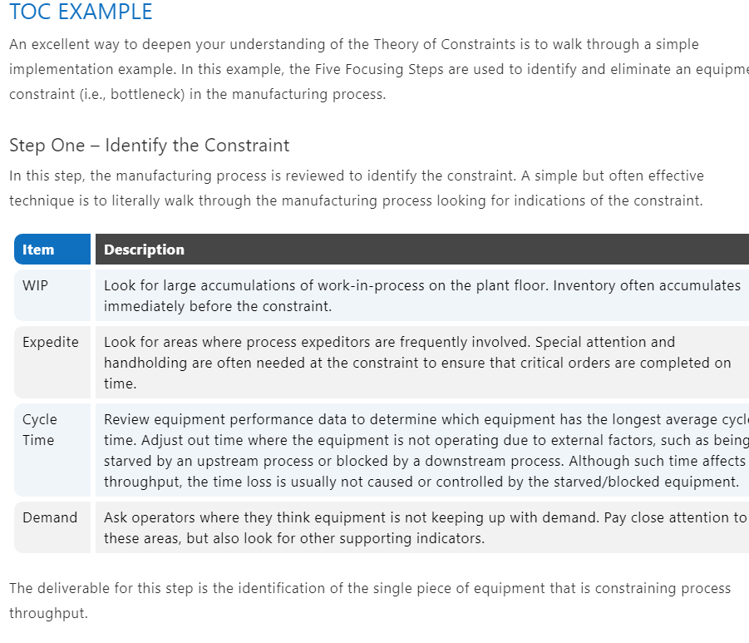

Slide 42
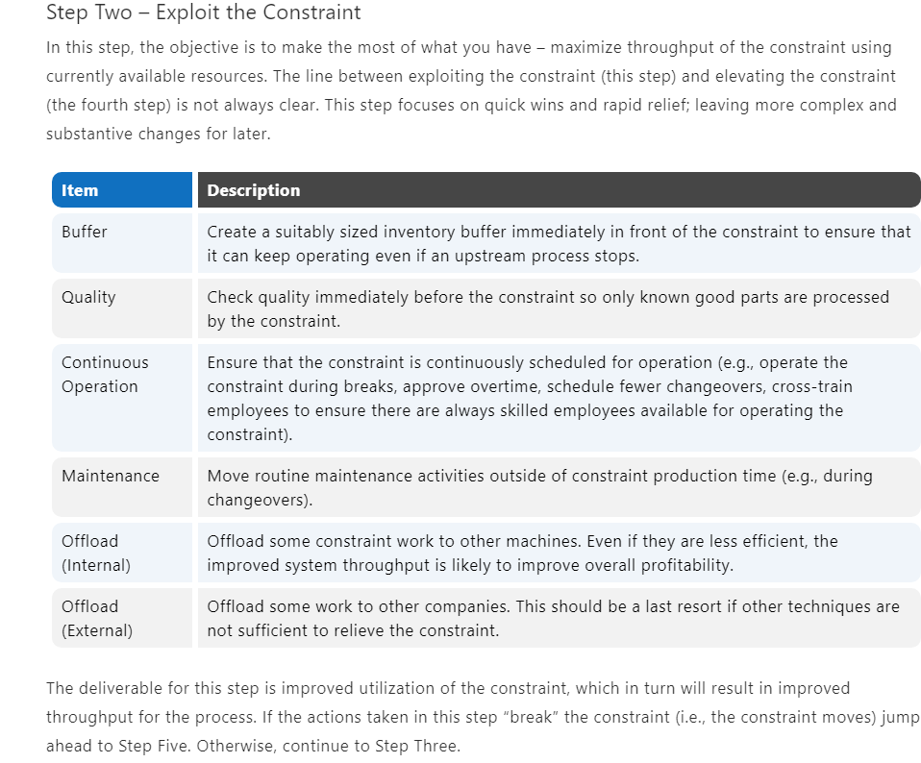

Slide 43
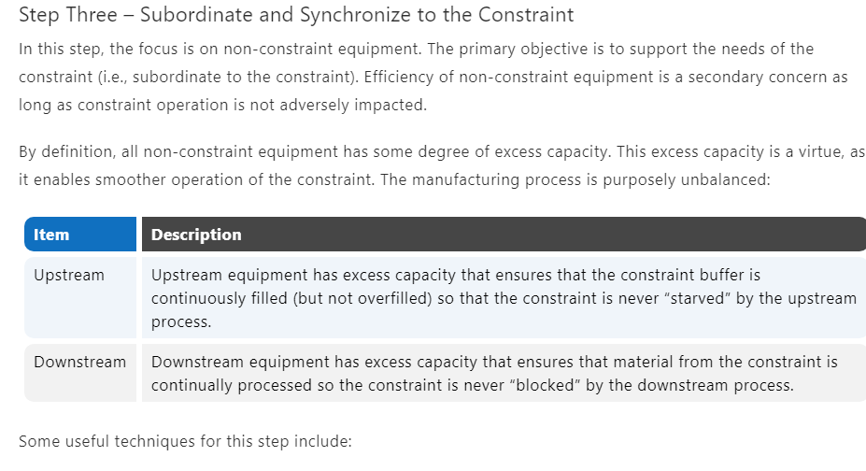

Slide 44
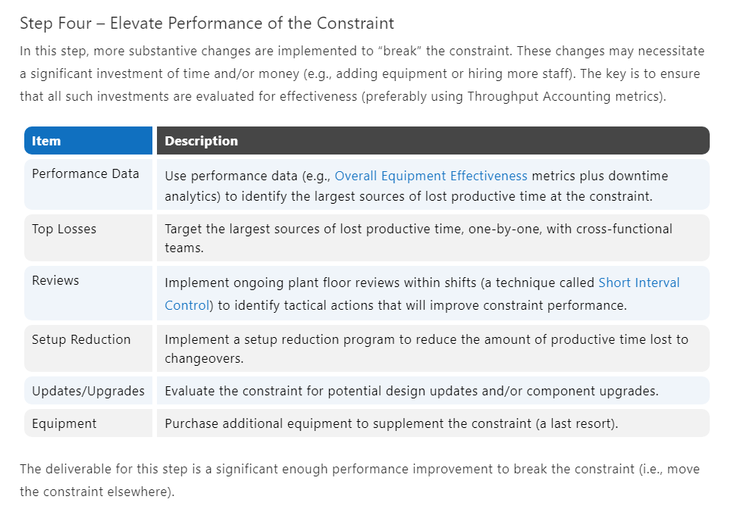

Slide 45
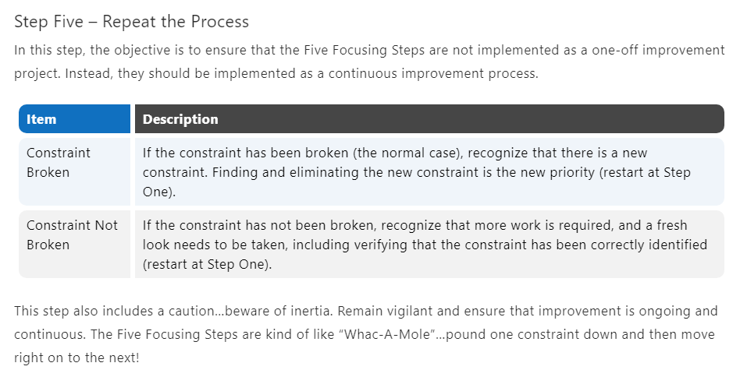

Slide 46
THANK YOU

